Slide 1
SigMatch Fast and Scalable Multi-Pattern Matching
2010 Very Large Data Base Endowment Inc. (2010 VLDB Endowment)
Author: Ramakrishnan Kandhan, Nikhil Teletia, Jignesh M. Patel
Presenter: Cheng-Feng Ke
Date: 2017/12/05
Department of Computer Science and Information Engineering
National Cheng Kung University, Taiwan R.O.C.
Notes:
1

Slide 2
INTRODUCTION
SigMatch uses a largely L1, L2 cache-resident q-gram index structure to quickly discard these no-match cases.
Thus, it dramatically reduces the number of main memory accesses, resulting in improved performance.
2-gram : ABCD => {AB, BC, CD}
3-gram : ABCD => {ABC, BCD}

Slide 3
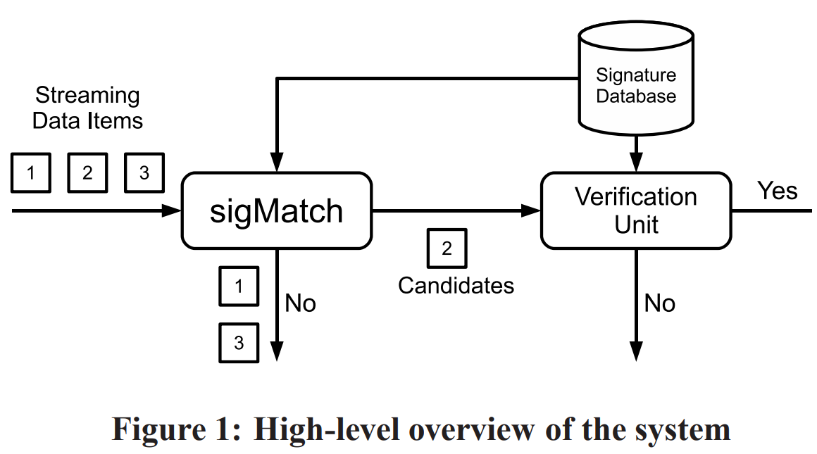
INTRODUCTION
ClamAV
signature
database
File
ClamAV
No-Match File

Slide 4
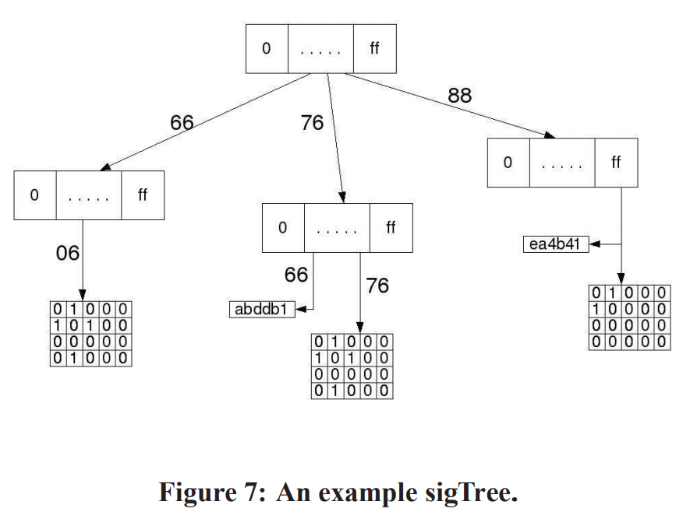
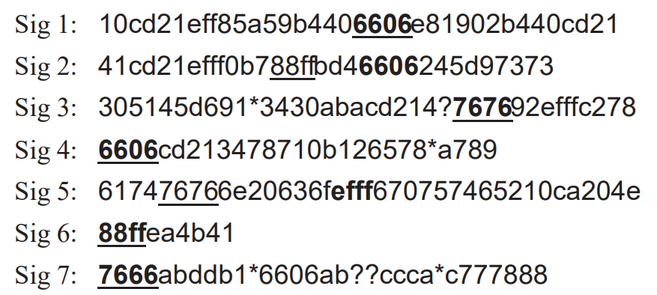
INTRODUCTION
Substring prefix length : 2 bytes
Substring suffix length : 4 bytes
Minimal 2-gram cover
{88ff, 7666, 7676, 6606}
xor+shift and RShash

Slide 5
Two-Level Hash Function
The idea here is to use multiple computationally cheap hash functions such as xor+shift [15] for the first few hash functions. For the last few hash functions, we choose expensive methods (RShash) to reduce the number of false positives.
The advantage with this technique is that the expensive hash methods are computed only when the first few hash methods return a false positive.
The disadvantage with using multiple hash functions is the additional computation involved when there is a match. Also when more hash functions are used, more bits are set to 1 in the Bloom filter, which reduces the filtering efficiency

Slide 6
Short Signature rewrite
For example the signature [A|a]b[C|c] is equivalent to the four signatures Abc, AbC, abC and abc.
We use similar rewrite rules in our implementation to ensure that we can find at least one substring in each pattern to index in the sigTree.

Slide 7
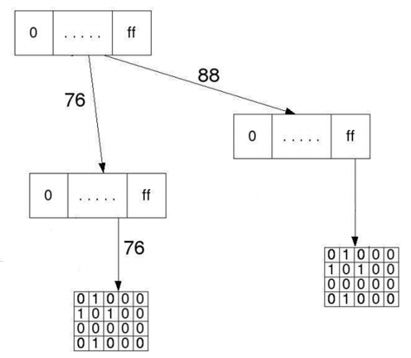
Data-Conscious SigMatch
Sig: 88ff41cd21ef7676245d9737
False positive 10 times
False positive 5 times

Slide 8
Evaluation
We tested sigMatch by integrating it with three real-world systems; namely, Bro – a network IDS, ClamAV – an anti-virus system, and DBLife [13] – an IE system that focuses on content of interest to the database community.
All experiments were run on a 2.00 GHz Intel Core 2 Duo processor with 3 GB RAM with Ubuntu 8.04 OS, 32 KB L1 cache and 2 MB L2 cache.

Slide 9
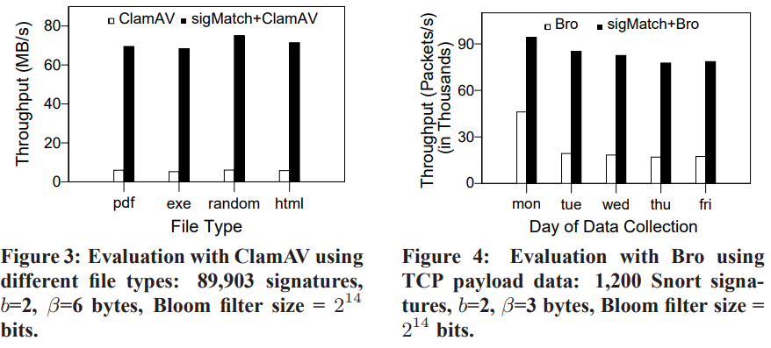
Evaluation
Throughput is defined as the amount of data scanned per second.

Slide 10
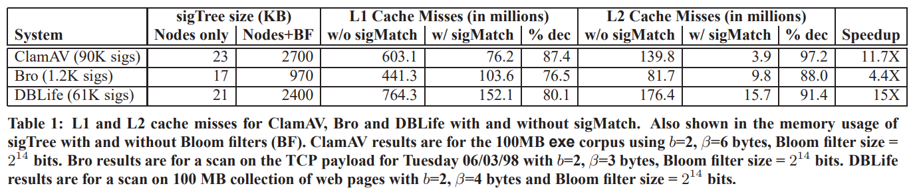
Evaluation
The ClamAV data structures require nearly 21 MB of memory in this experiment. Since the L2 cache is only 2MB, most of the structure resides in the main memory. As a result, ClamAV tends to require at least one random memory access per scanned byte.

Slide 11
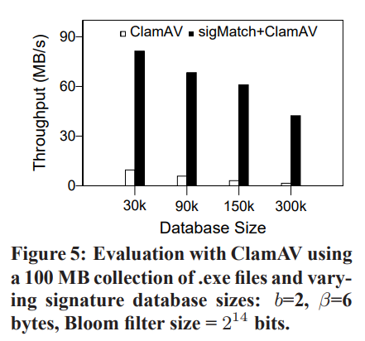
Evaluation
Throughput is defined as the amount of data scanned per second.

Slide 12
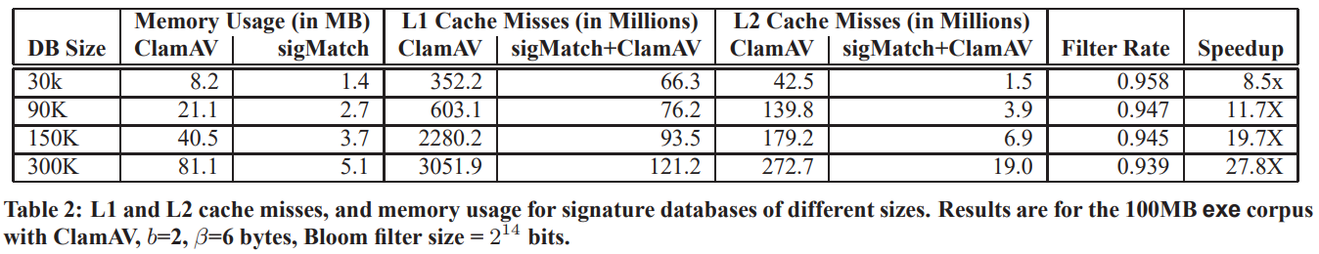
Evaluation
Filter rate is the fraction of the data items thrown out by sigMatch, i.e. the fraction of data items that are true negatives as detected by sigMatch.

Slide 13
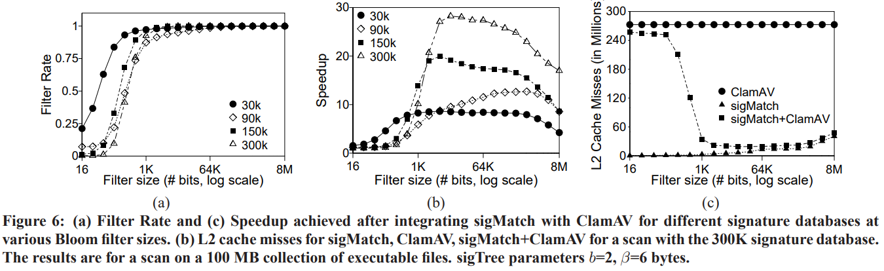
Evaluation

Slide 14
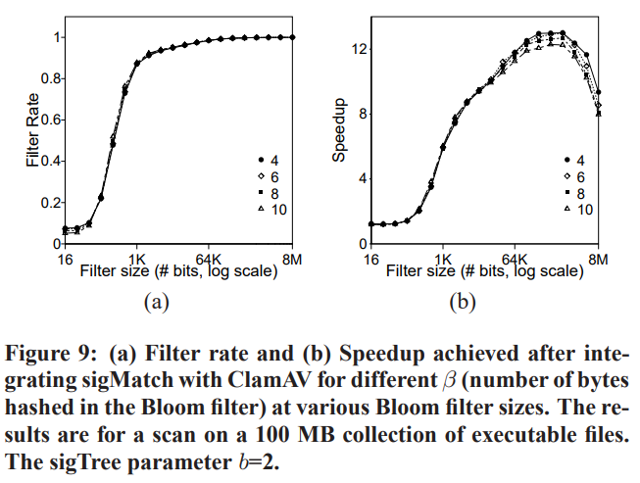
Evaluation

Slide 15
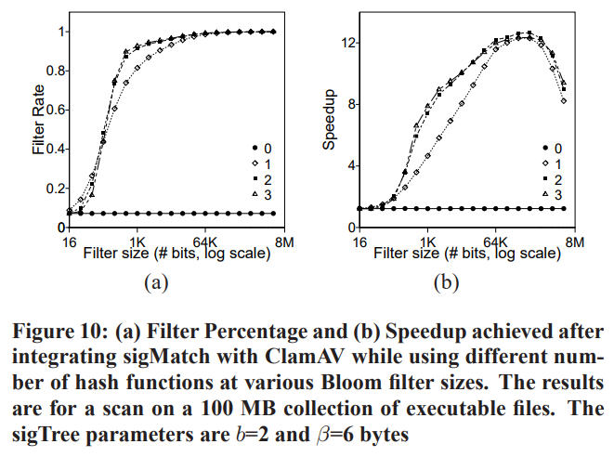
Evaluation

